Slide 1
Mathematics
“To ask the right question is harder than to answer it”
-Georg Cantor

Slide 2
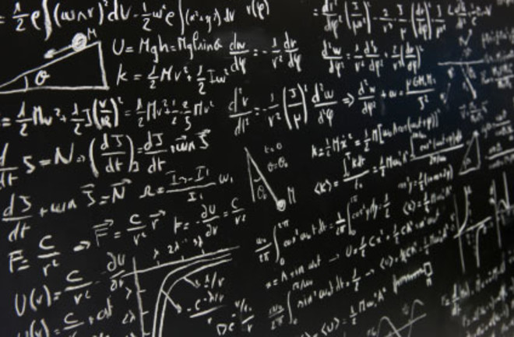
What is Mathematics?
Mathematics is an area of knowledge which focuses on proving statements and finding different values.
It has four branches: Number Theory,Algebra,Geometry and Analysis.

Slide 3
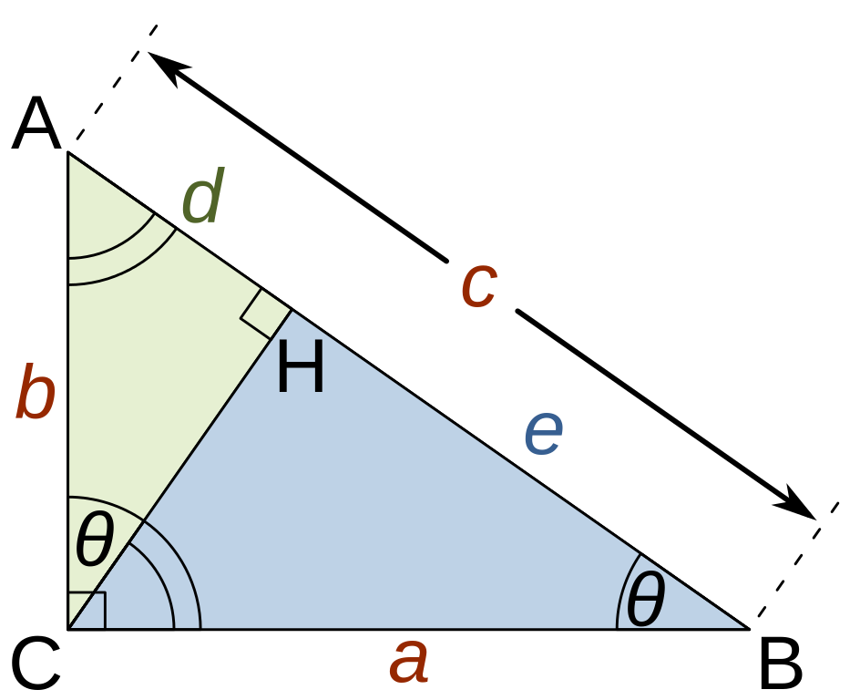
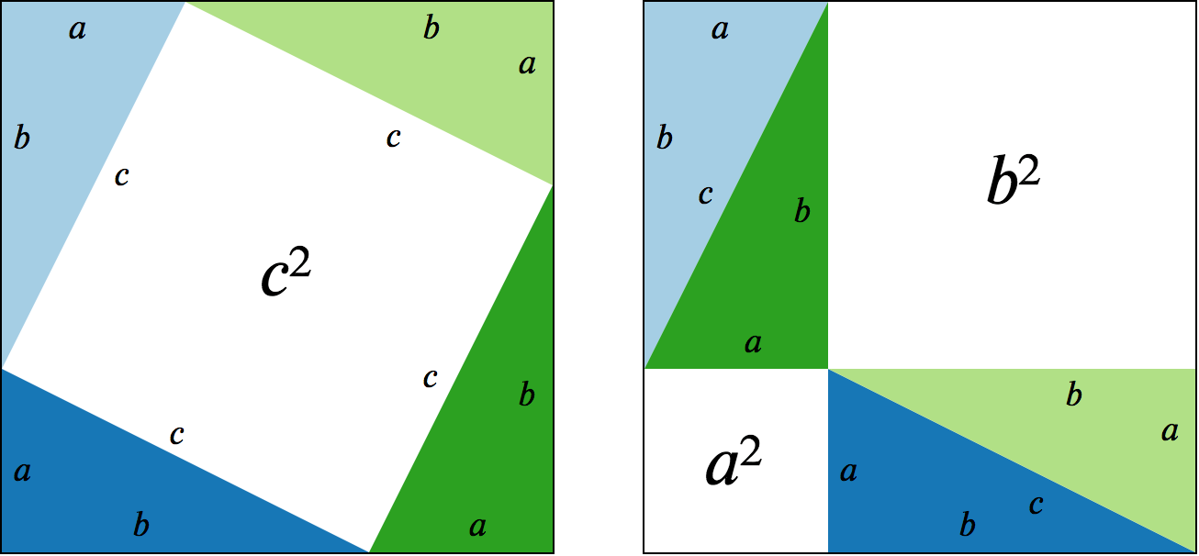
Proofs
Proofs=arguments which show us why some statements are true

Slide 4
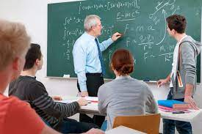

Mathematics as a job

Slide 5
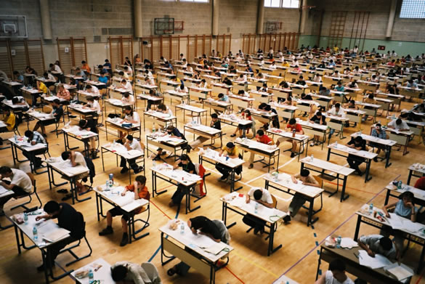
Do you have what it takes to work in Mathematics?

Slide 6
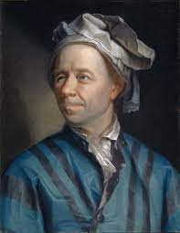
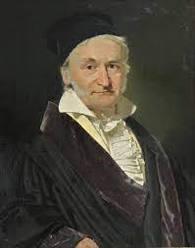
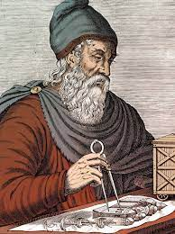
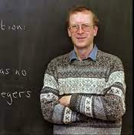
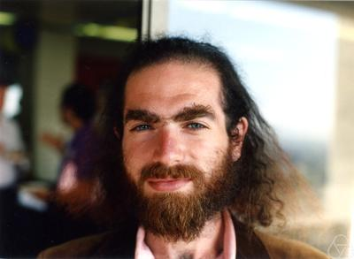
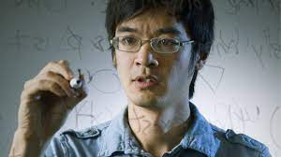
Famous mathematicians

